Slide 1


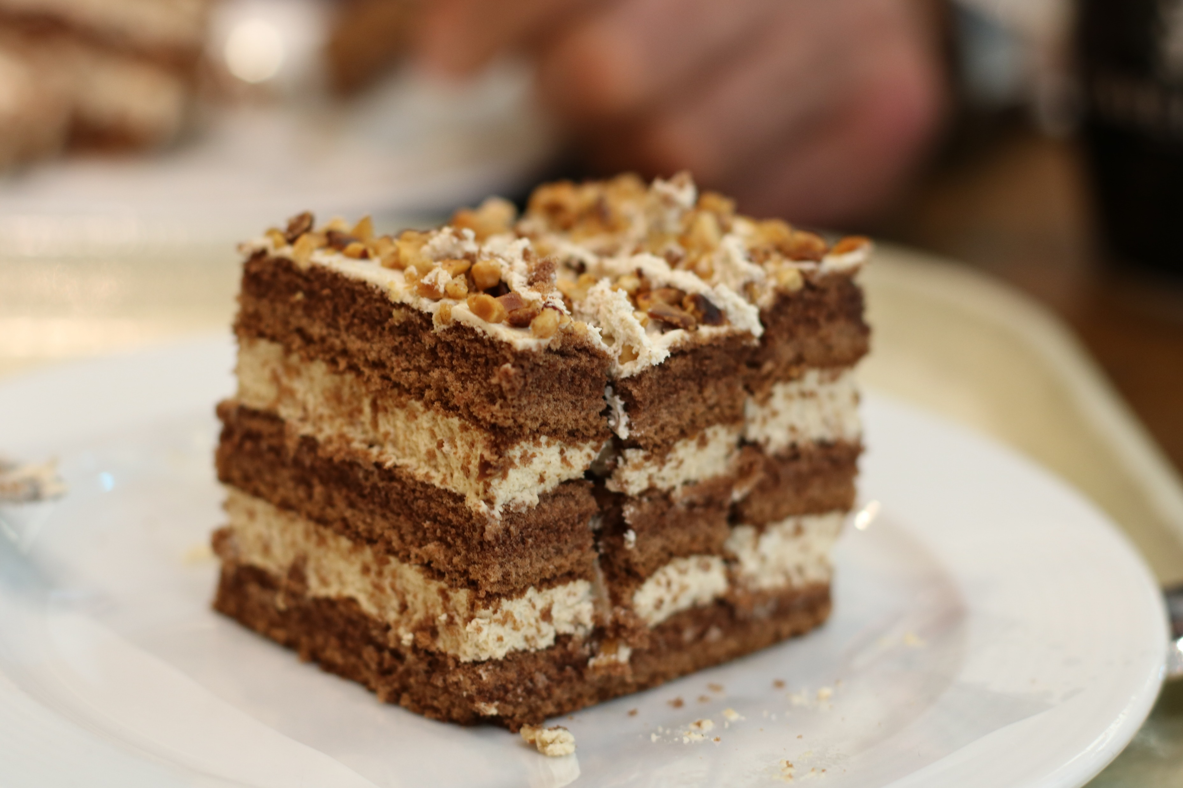




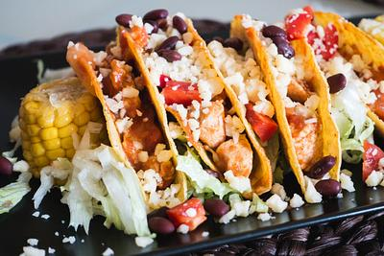
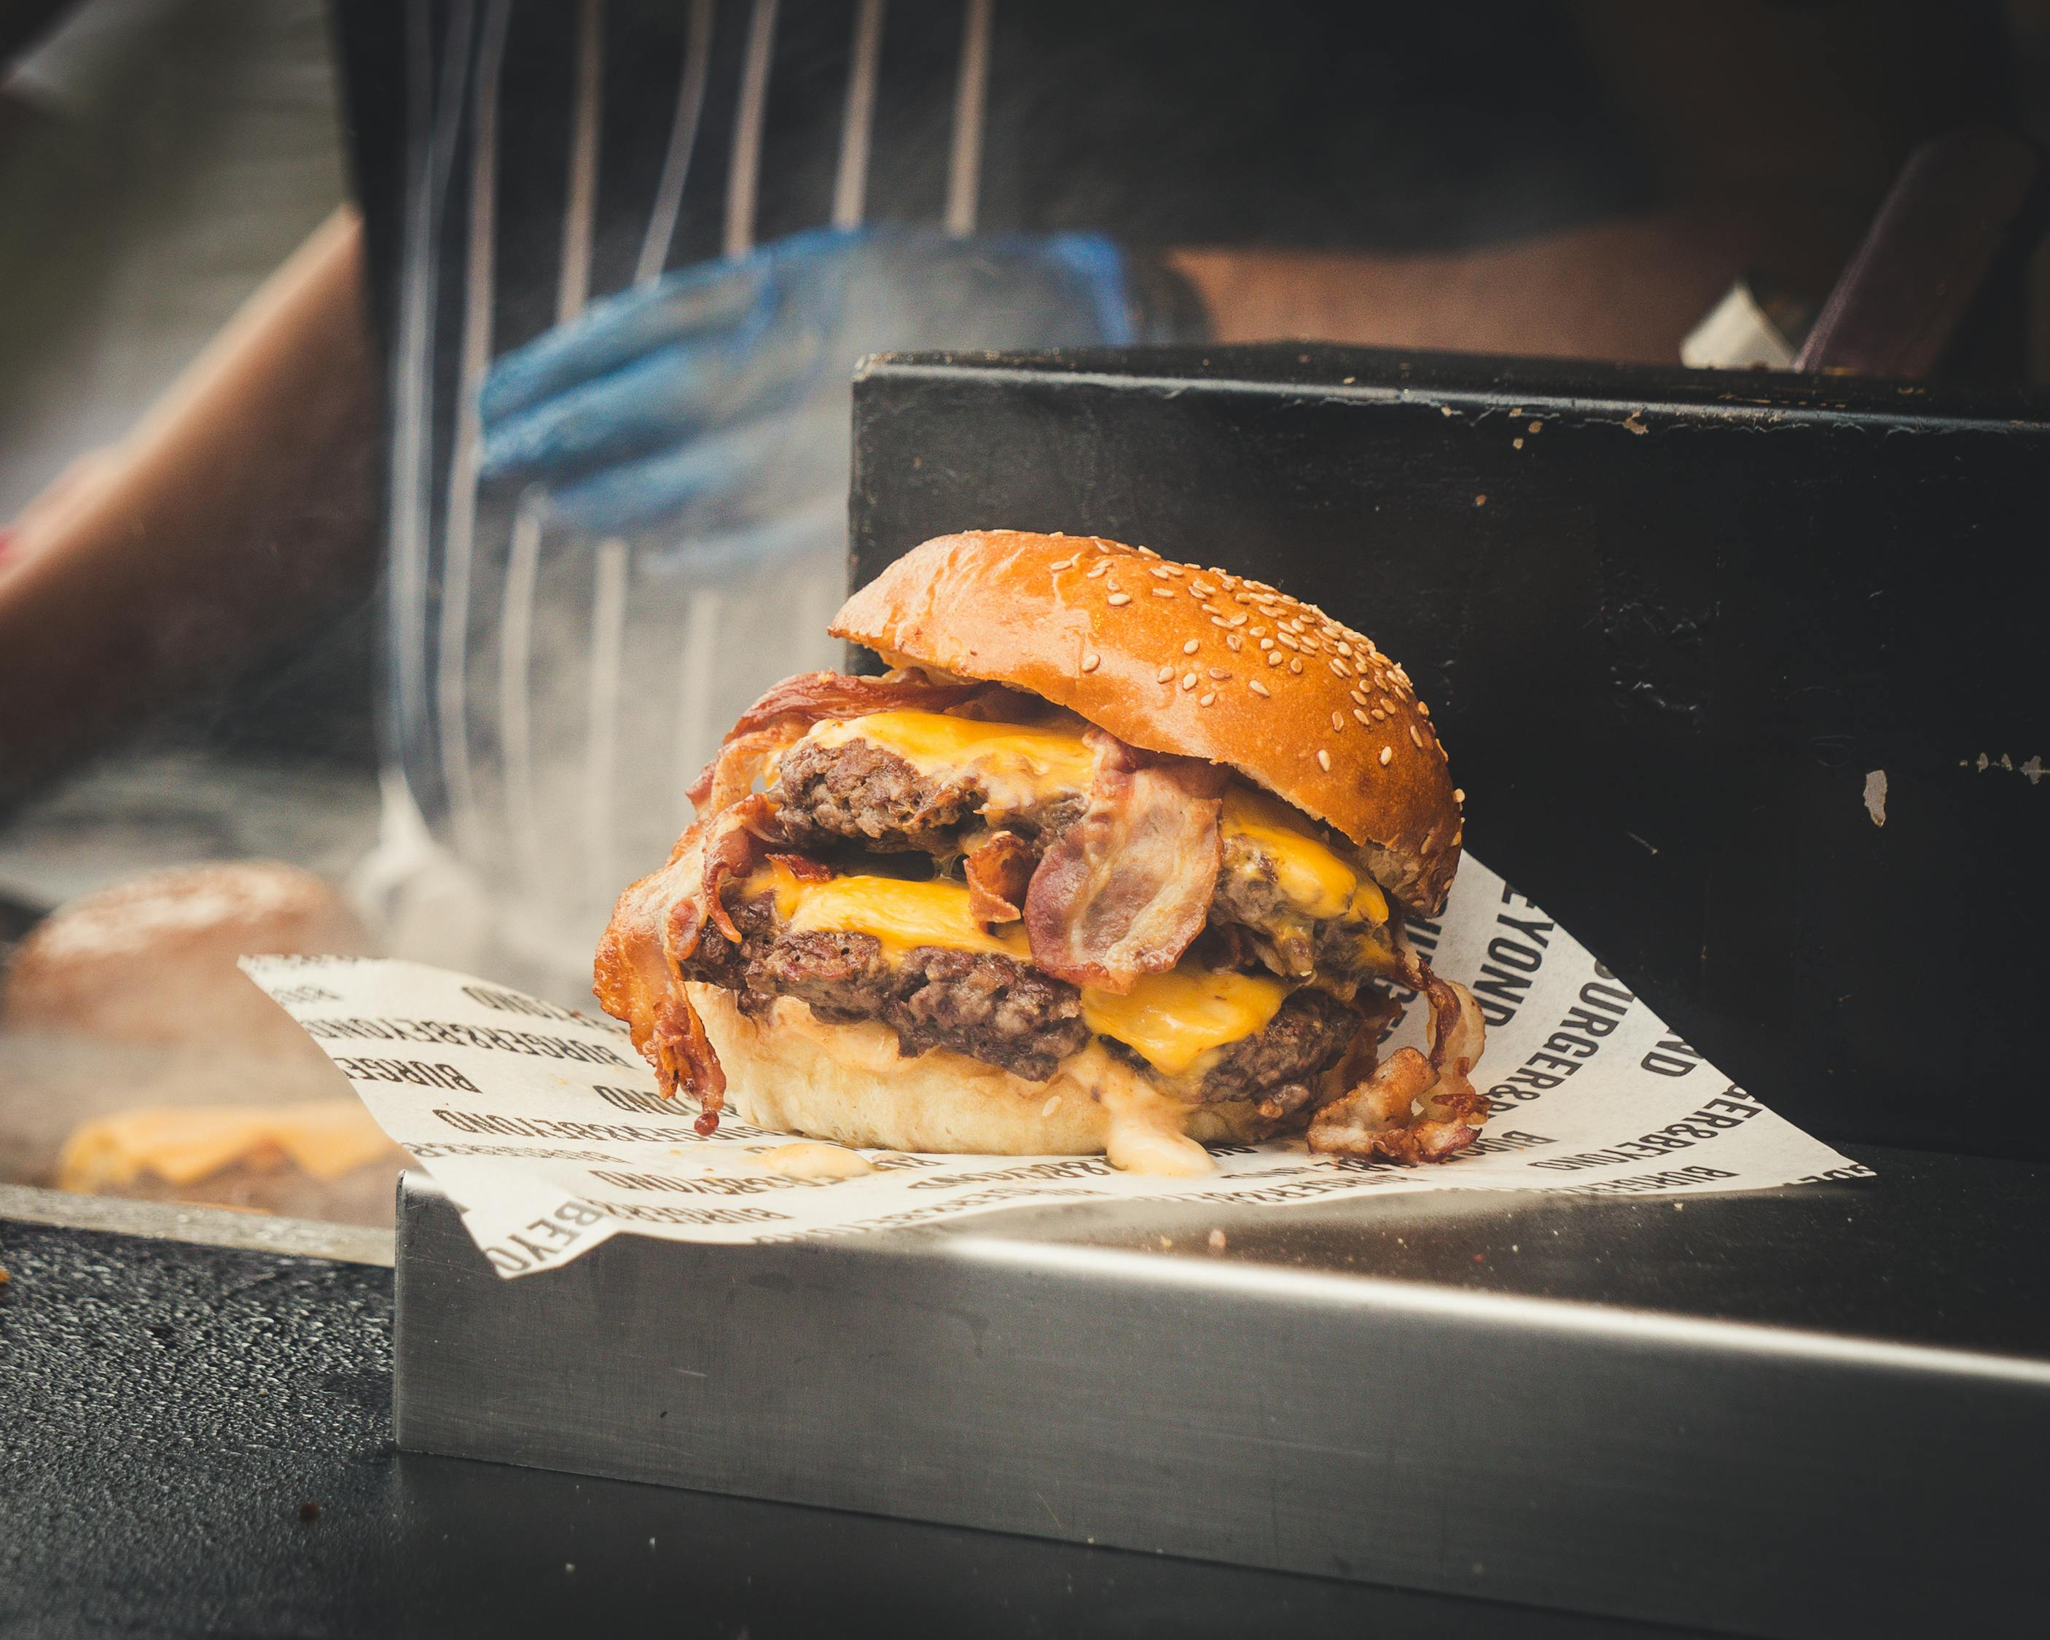

Slide 2

MAVEN ANALYTICS RESTAURANTS ORDER ANALYSIS
Tools Used: -
MySQL - For ETL and EDA.
Jupyter Notebook - Python MySQL. Connector Module and Pandas

Slide 3
Project Overview
This data analysis project aims to provide insights into the sales performance of an international Restaurant. By analyzing various aspects of the sales data, we seek to identify trends, make data-driven recommendations, and gain a deeper understanding of the company's performance.
Data sources
Item data: The primary dataset used for this analysis is the Menu_item file, containing detailed information about each Menu made by the company.
Order details data: The primary dataset used for this analysis is the Order_details file, containing detailed information about each order obtained by the company.

Slide 4
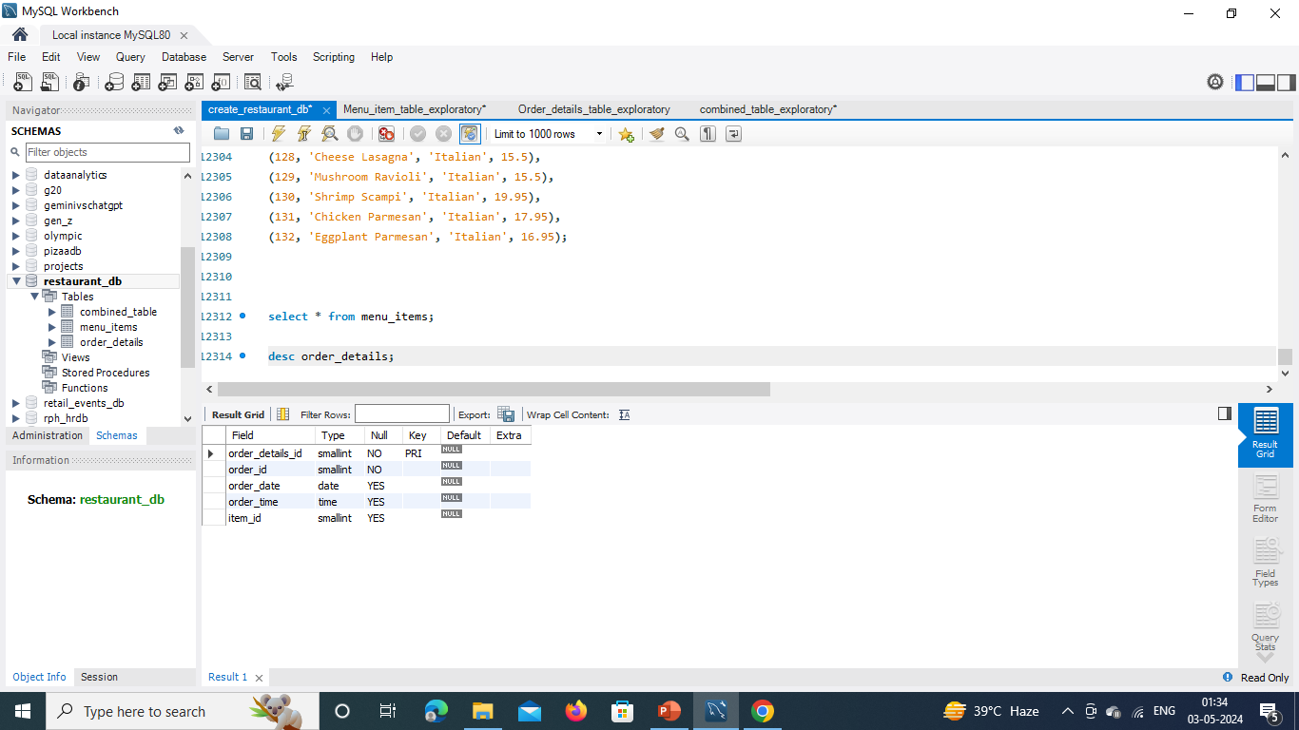
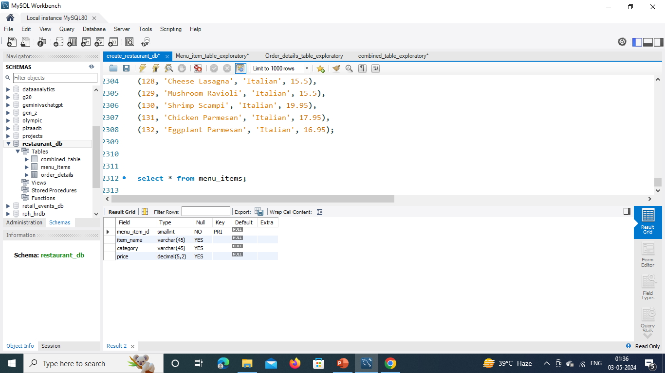
Order Details Schema
Menu items Schema

Slide 5

Menu Items Table Exploratory Analysis

Slide 6
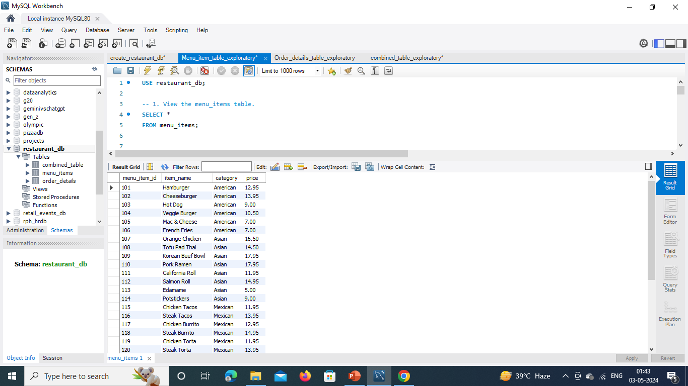
-- 1. View the menu items table.
SELECT *FROM menu_ items ;

Slide 7
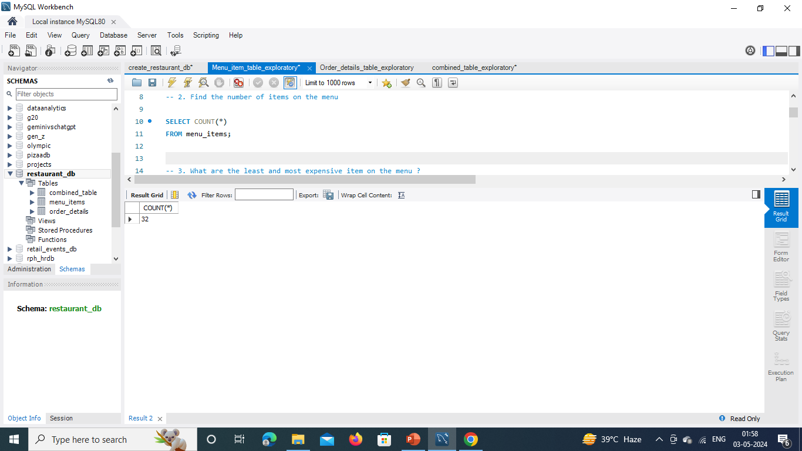
-- 2. Find the number of items on the menu
SELECT COUNT(*) FROM menu_ items ;

Slide 8
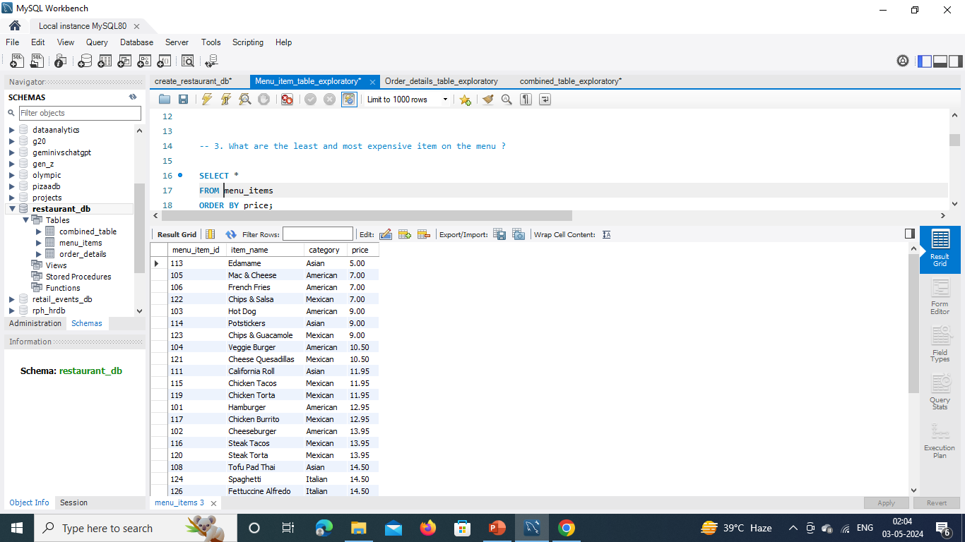
-- 3. What are the least and most expensive items on the menu?
SELECT * FROM menu_ items ORDER BY price;

Slide 9
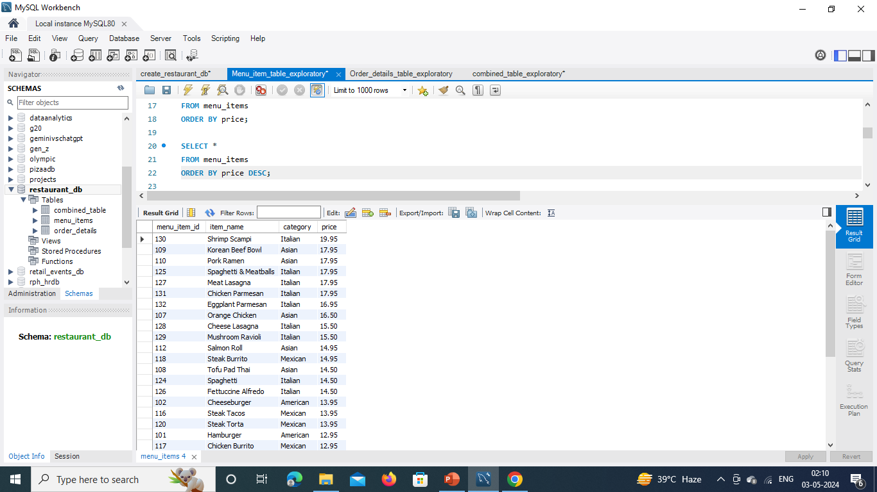
SELECT * FROM menu_ items ORDER BY price DESC;

Slide 10

-- 4. How many Italian dishes are on the menu?
SELECT COUNT(*) FROM menu_ items WHERE category = 'italian’ ;

Slide 11
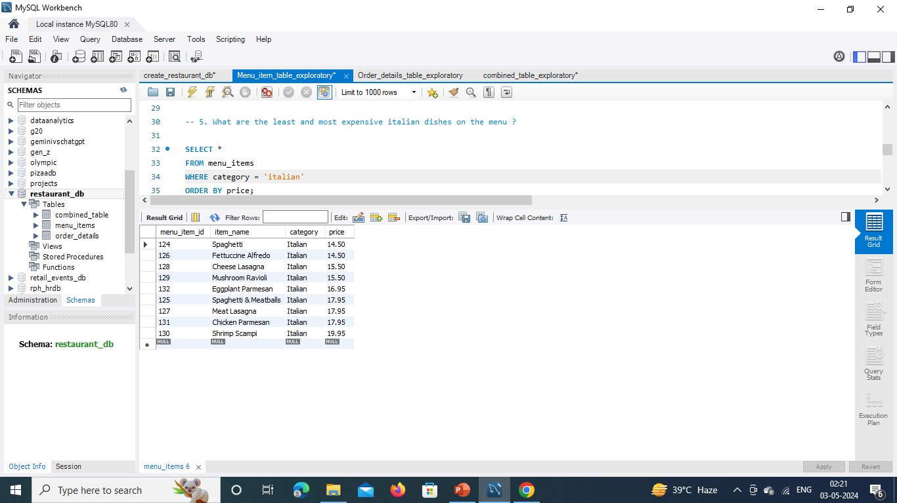
-- 5. What are the least and most expensive Italian dishes on the menu?
SELECT * FROM menu_ items
WHERE category = ‘Italian’
ORDER BY price;

Slide 12
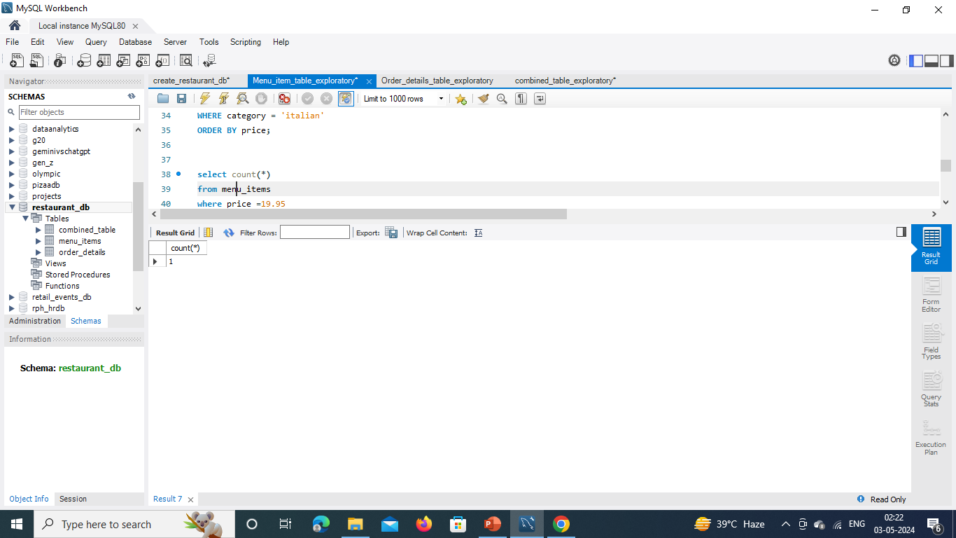
select count(*) from menu_ items
where price =19.95
group by price;

Slide 13
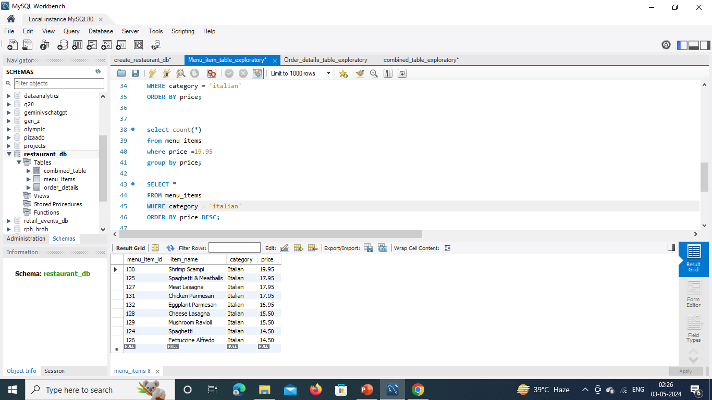
SELECT * FROM menu_ items
WHERE category = ‘Italian’
ORDER BY price DESC;

Slide 14
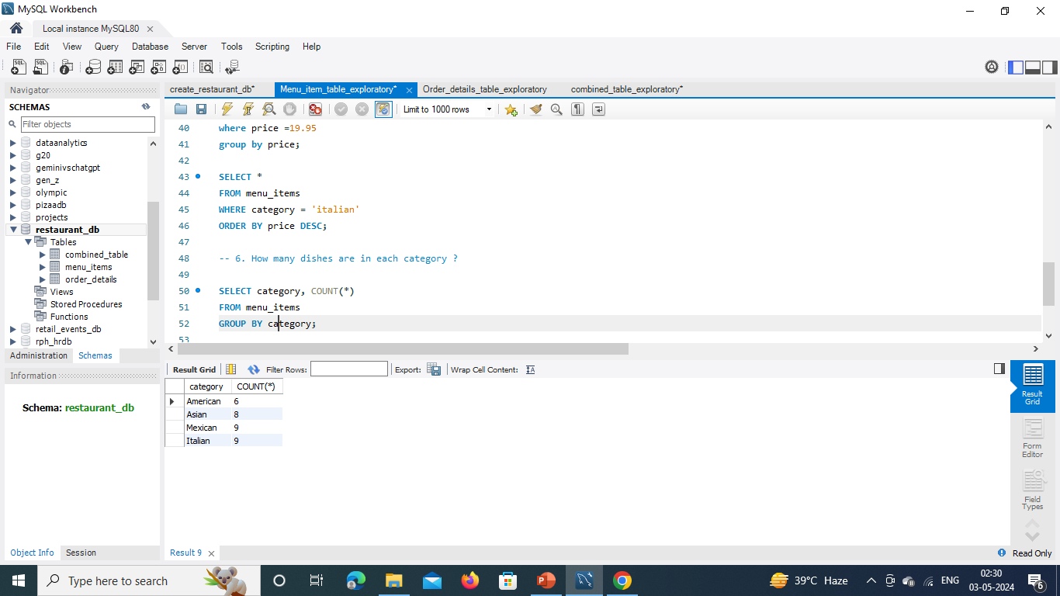
-- 6. How many dishes are in each category?
SELECT category, COUNT(*)
FROM menu_ items
GROUP BY category;

Slide 15
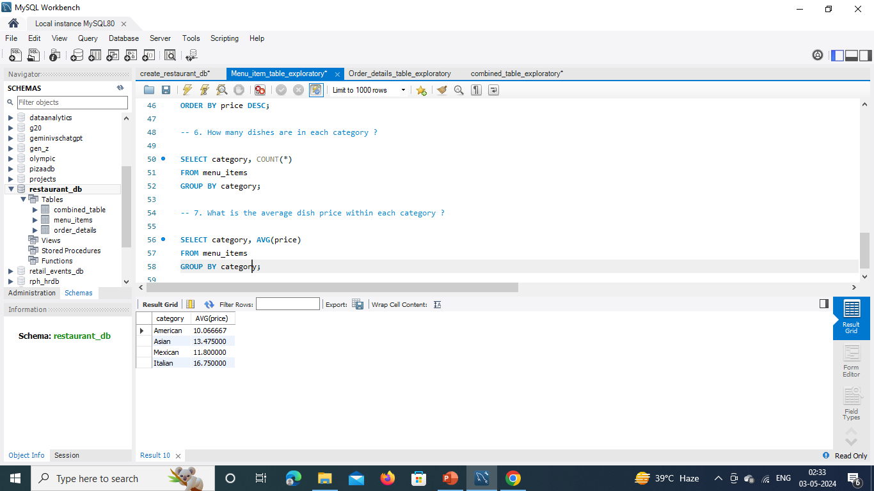
-- 7. What is the average dish price within each category?
SELECT category, AVG(price) FROM menu_ items
GROUP BY category;

Slide 16

Order Details Table Exploratory
Analysis

Slide 17
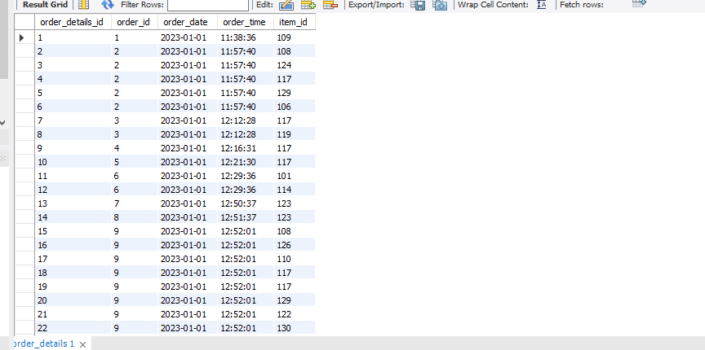
-- 1. View order_ details table.
SELECT *FROM order_ details;

Slide 18
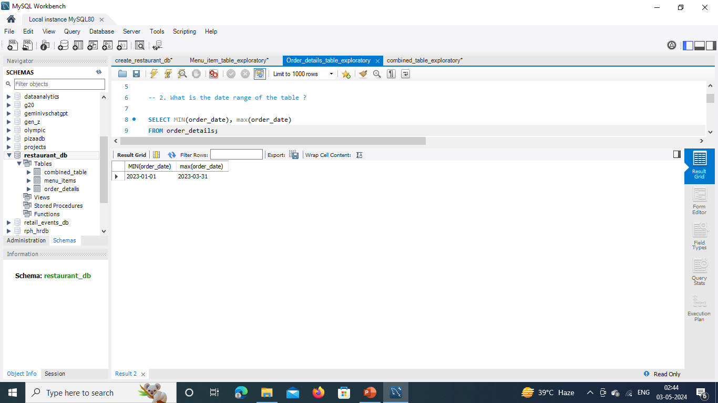
-- 2. What is the date range of the table?
SELECT min(order_ date), max(order_ date)
FROM order_ details;

Slide 19
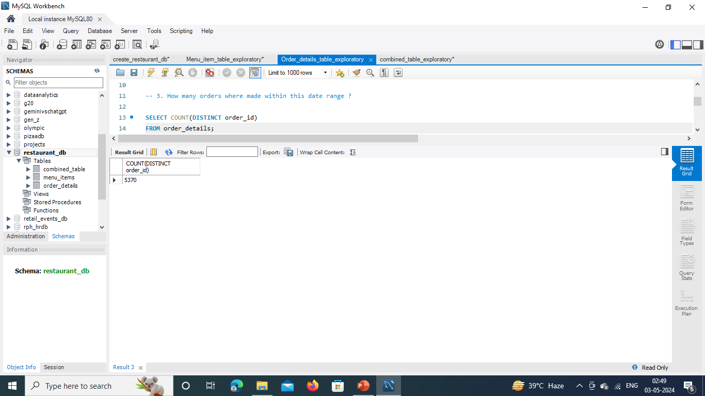
-- 3. How many orders were made within this date range?
SELECT COUNT(DISTINCT order_ id) FROM order_ details;

Slide 20

-- 4. How many items were ordered within this date range?
SELECT COUNT(*) FROM order_ details;

Slide 21
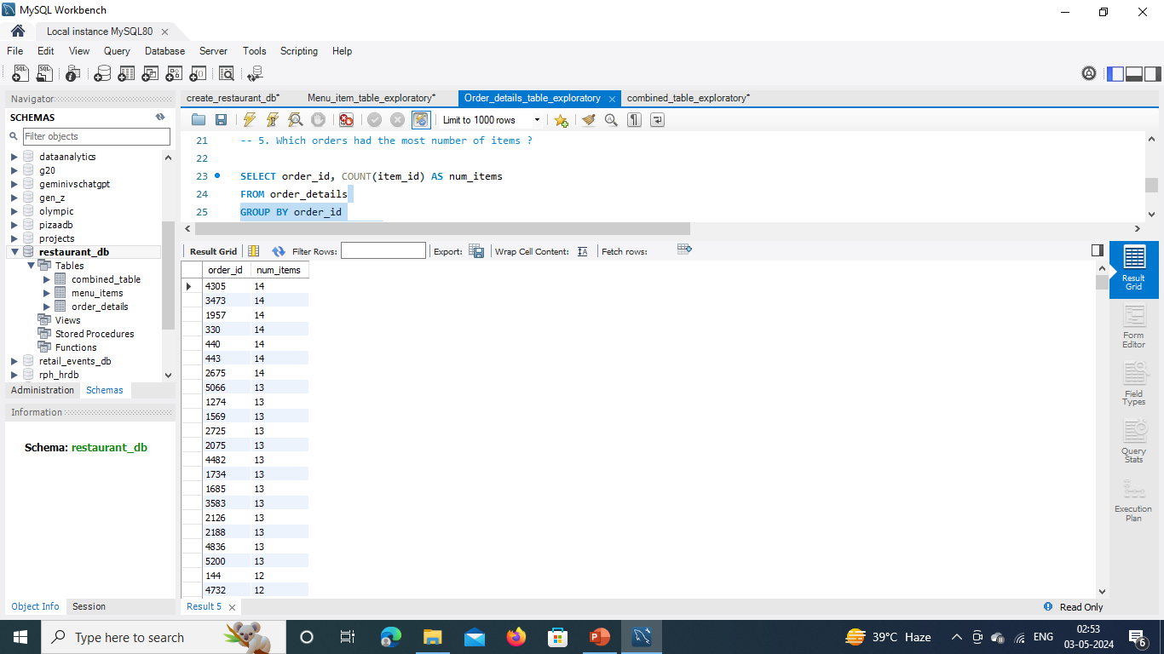
-- 5. Which orders had the most number of items?
SELECT order_ id, COUNT(item_ id) AS num_ items
FROM order_ details GROUP BY order_ id ORDER BY num_ items DESC;

Slide 22
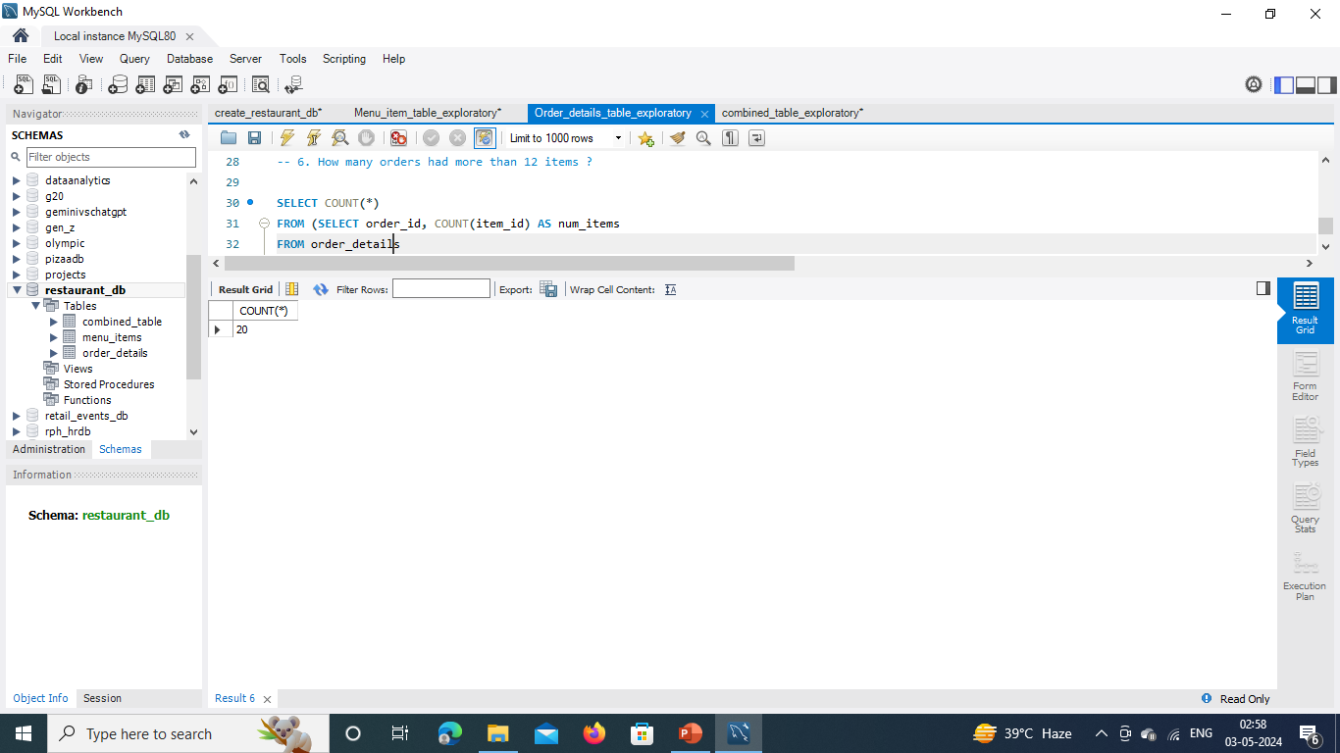
-- 6. How many orders had more than 12 items?
SELECT COUNT(*) FROM (SELECT order_ id, COUNT(item_ id) AS num_ items FROM order_ details GROUP BY order_ id HAVING num_ items > 12) AS num_ orders;

Slide 23

Combined Table Exploratory
Analysis

Slide 24
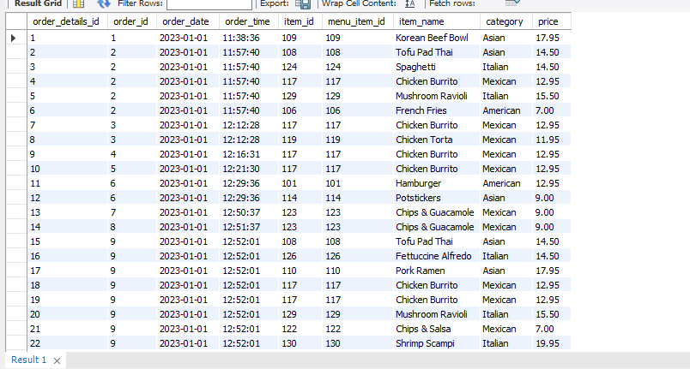
-- 1. Combine the menu_ items table and order_ details table into a single table.
- SELECT * FROM menu_ items;
- SELECT * FROM order_ details;
- SELECT * FROM order_ details od LEFT JOIN menu_ items mi ON od. item_ id = mi. menu_ item_ id;

Slide 25
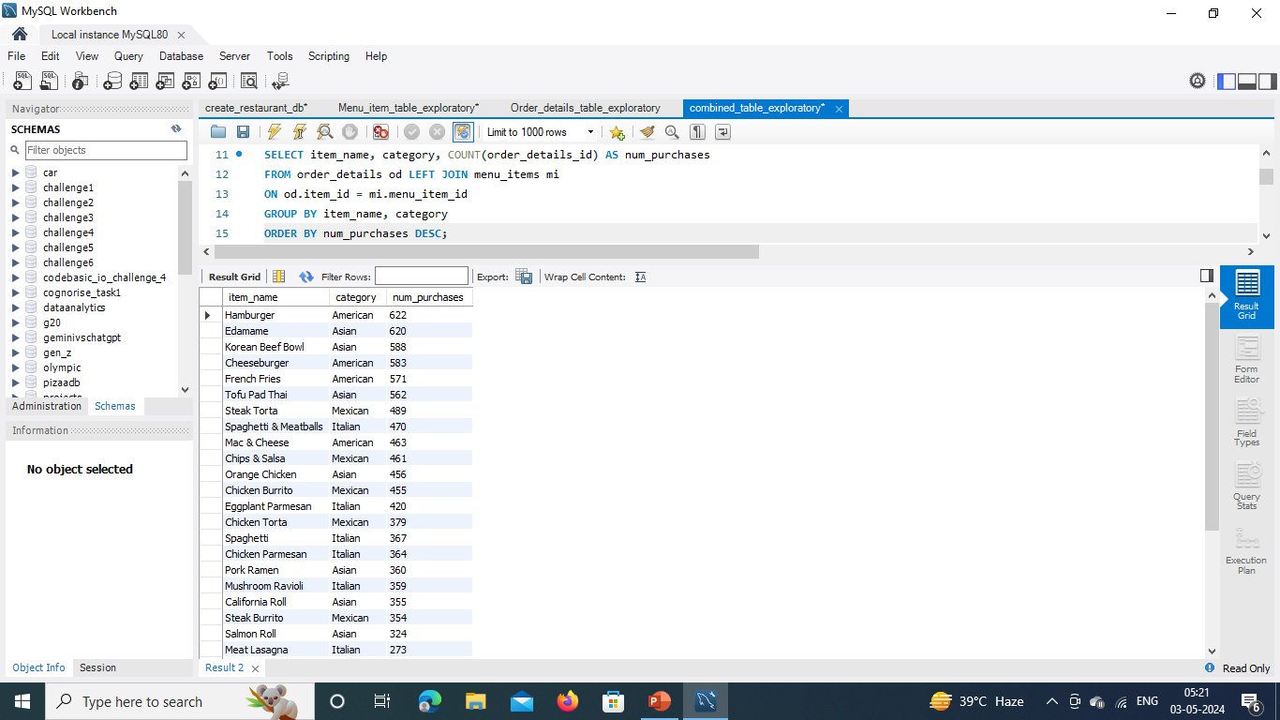
-- 2. What were the least and most ordered items? What categories were they in?
SELECT item_ name, category, COUNT(order_ details_ id) AS num_ purchases FROM order_ details od LEFT JOIN menu_ items mi ON od. item_ id = mi. menu_ item_ id GROUP BY item_ name, category ORDER BY num_ purchases DESC;

Slide 26
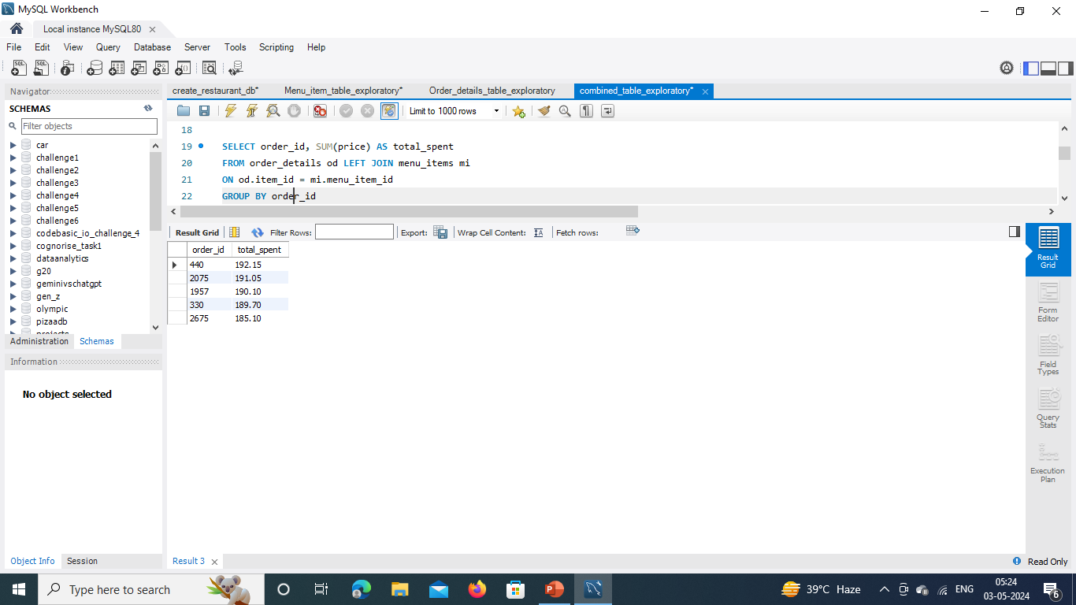
-- 3. What were the top 5 orders that spent the most money?
SELECT order_ id, SUM(price) AS total_ spent FROM order_ details od LEFT JOIN menu_ items mi ON od.item_ id = mi.menu_ item_ id
GROUP BY order_ id
ORDER BY total_ spent DESC LIMIT 5 ;

Slide 27
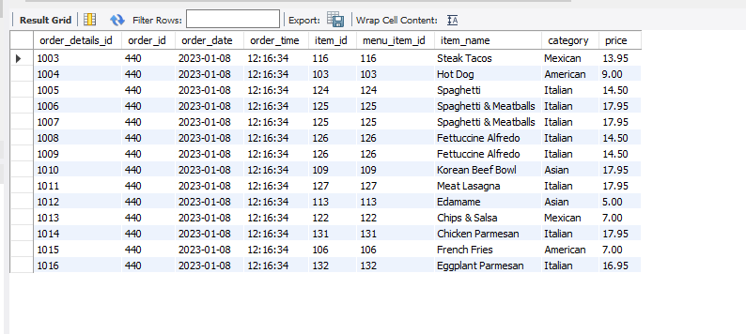
-- 4. View the details of the highest spent order. What insights can you gather from them?
SELECT * FROM order_ details od
LEFT JOIN menu_ items mi ON od. item_ id = mi. menu_ item_ id
WHERE order_ id = 440 ;

Slide 28
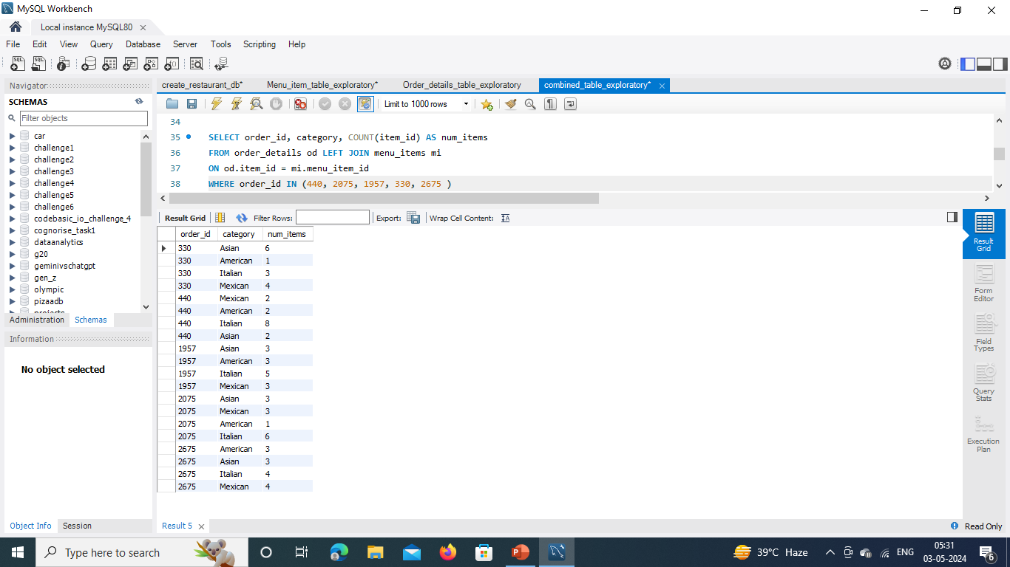
-- 5. View the details of the top 5 highest spent orders. What insights can you gather from them?
SELECT order_ id, category, COUNT(item_ id) AS num_ items FROM order_ details od LEFT JOIN menu_ items mi ON od. item_ id = mi. menu_ item_ id WHERE order_ id IN (440, 2075, 1957, 330, 2675 )
GROUP BY order_ id, category;

Slide 29
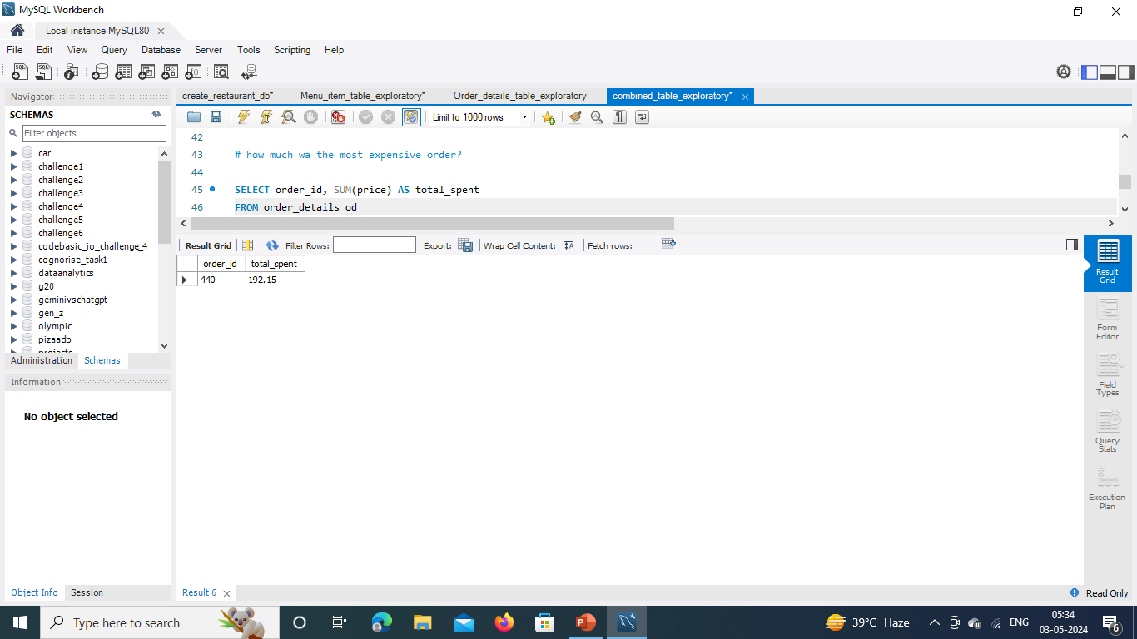
# How much was the most expensive order?
SELECT order_ id, SUM(price) AS total_ spent FROM order_ details od
LEFT JOIN menu_ items mi ON od. item_ id = mi. menu_ item_ id
GROUP BY order_ Id
ORDER BY total_ spent DESC
LIMIT 1;

Slide 30
Thank You ………………….
By
Rupal Hiwarkar

